Slide 1
Building a Bluetooth-Controlled Smart Home with Atmega32 Microcontroller
A graduation project from Imt AVR diploma

Slide 2
Outline
Introduction
Hardware Setup
ATmega32 Ports
Software Implementation

Slide 3
Introduction
In recent years, the concept of smart homes has gained significant traction, offering convenience, efficiency, and enhanced security.
This article presents an embedded system graduation project that utilizes an Atmega32 microcontroller to create a Bluetooth-controlled smart home.
The system allows users to control LED lights and a door locker using a Bluetooth module, making home automation accessible and effortless. Let's delve into the details of this innovative project.

Slide 4
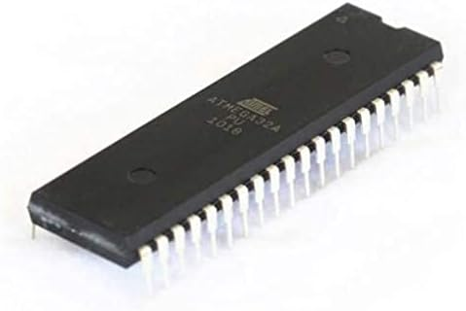
Hardware Setup
Atmega32 Microcontroller: The Atmega32 serves as the brain of the system, responsible for processing user commands and controlling the connected devices.

Slide 5
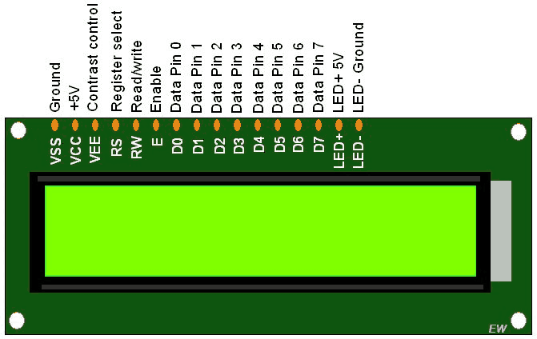
Hardware Setup
LCD Display: An LCD display provides a user-friendly interface to display system status, instructions, and feedback.

Slide 6
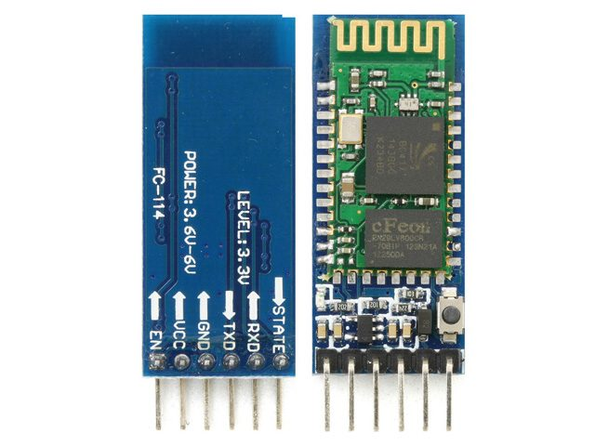
Hardware Setup
Bluetooth Module: The Bluetooth module enables communication between the microcontroller and the user's smartphone via Bluetooth technology.

Slide 7
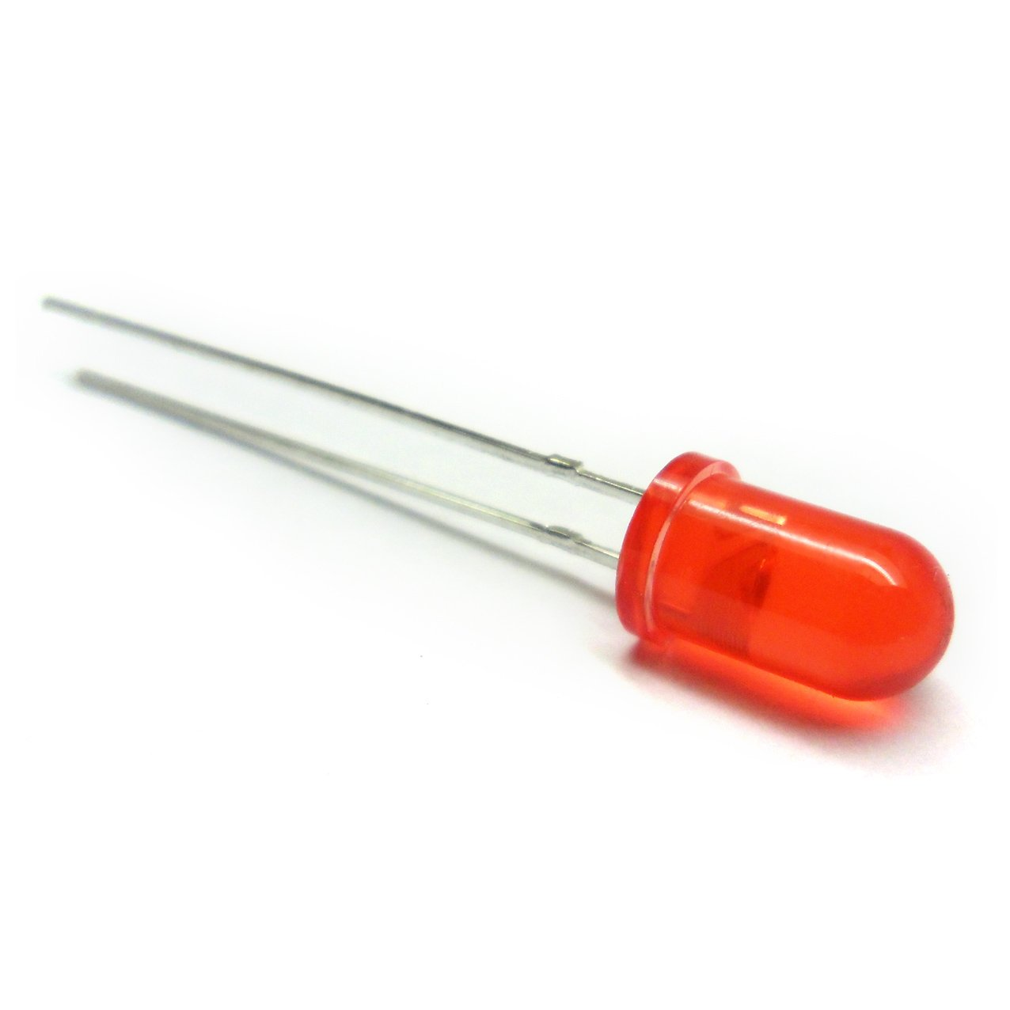
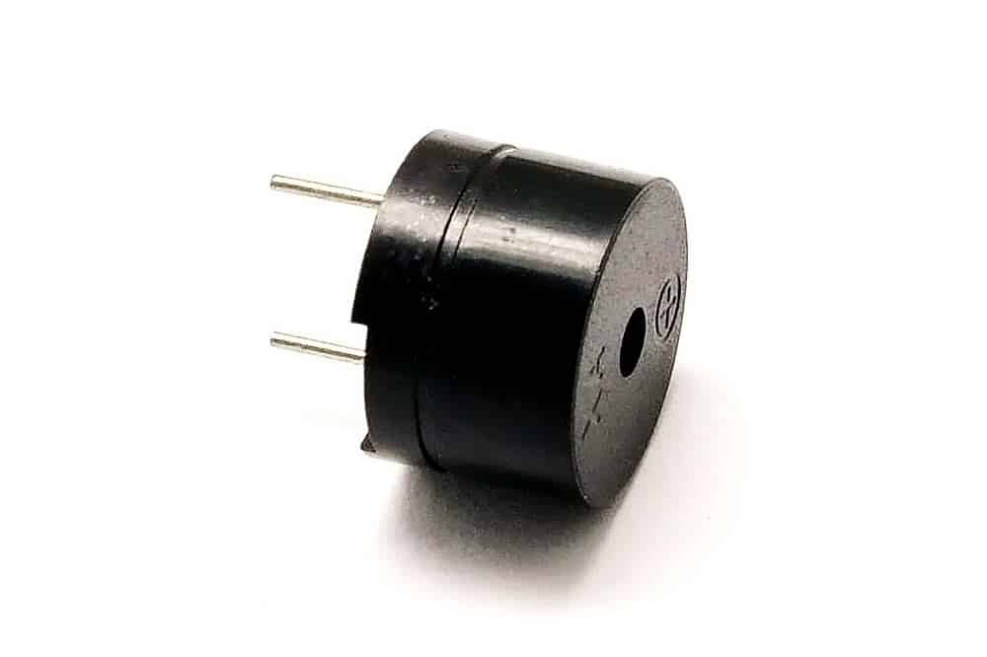
Hardware Setup
LEDs: Light-emitting diodes (LEDs) are used to illuminate various areas within the smart home.
Buzzer: The buzzer generates audible alerts or notifications for certain events or user interactions.

Slide 8
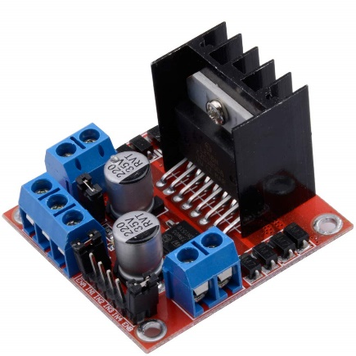
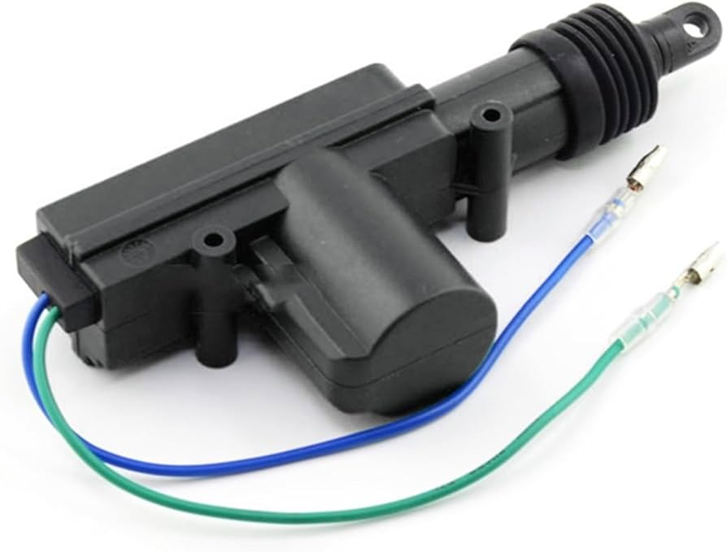
Hardware Setup
Car Central Locking System: The project integrates with the car's central locking system, allowing users to lock and unlock their vehicles remotely.
H-Bridge L982N: An H-bridge is an essential electronic circuit used to control the direction of current flow

Slide 9
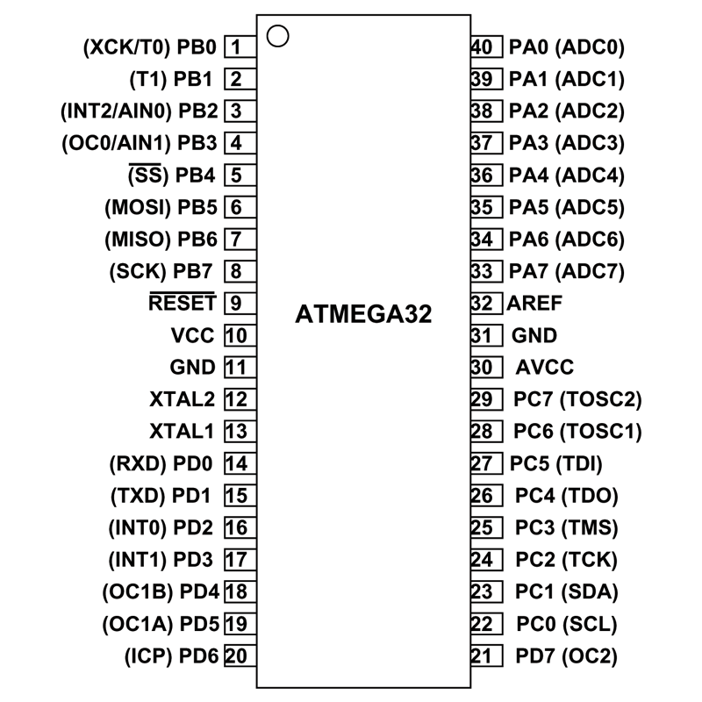
ATmega32 Ports

Slide 10
ATmega32 Ports
PORT | PIN | Function
Port A | 0 | L298n IN1(Alarm)
Port A | 1 | L298n IN2(Alarm)
Port A | 2 | L298n IN3(Door)
Port A | 3 | L298n IN4(Door)
Port A | 4 | LED Pin
Port A | 5 | -
Port A | 6 | -
Port A | 7 | -

Slide 11
ATmega32 Ports
PORT | PIN | Function
Port B | 0 | -
Port B | 1 | -
Port B | 2 | -
Port B | 3 | -
Port B | 4 | -
Port B | 5 | -
Port B | 6 | -
Port B | 7 | -

Slide 12
ATmega32 Ports
PORT | PIN | Function
Port C | 0 | LCD(data port)
Port C | 1 | LCD(data port)
Port C | 2 | LCD(data port)
Port C | 3 | LCD(data port)
Port C | 4 | LCD(data port)
Port C | 5 | LCD(data port)
Port C | 6 | LCD(data port)
Port C | 7 | LCD(data port)

Slide 13
ATmega32 Ports
PORT | PIN | Function
Port D | 0 | Rx (HC-05 Tx)
Port D | 1 | Tx (HC-05 Rx)
Port D | 2 | -
Port D | 3 | LCD(Control Port E)
Port D | 4 | LCD(Control Port RW)
Port D | 5 | LCD(Control Port RS)
Port D | 6 | -
Port D | 7 | -

Slide 14
Software Implementation
Development Environment

Slide 15
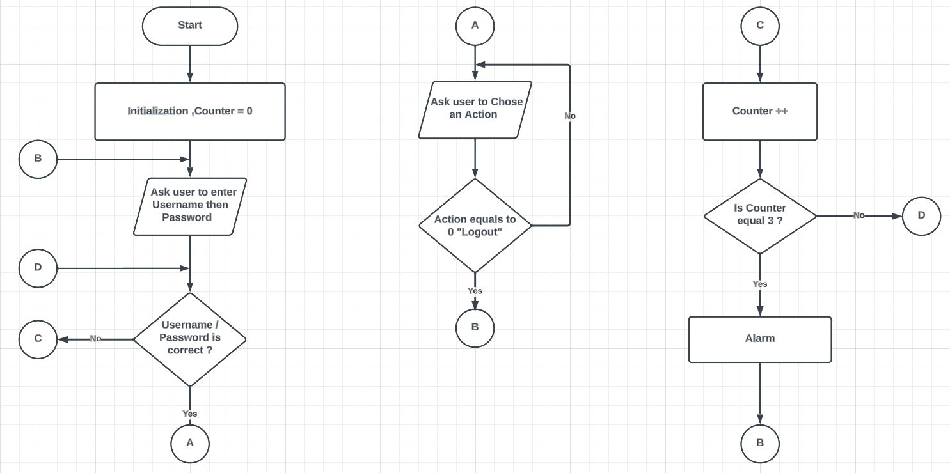
Flow Chart

